Slide 1
BIOTECHNOLOGY BREAKTHROUGH HACKATHON
Problem statement: Track 2: Agriculture/food-tech : Mobile app/AI-based application for soil/crop/water health
Title of Idea: Indian Crop Analyzer
Name of Team Member 1
Semester/program
Saanvi Panchal
I Semester
BTech Biotechnology
Name of Team Member 2
Semester/Discipline
Dhrumi Lolariya
I Semester
BTech Biotechnology
Name of Team Member 3
Semester/ Discipline
Swati Shukla
I Semester
BTech Biotechnology

Slide 2
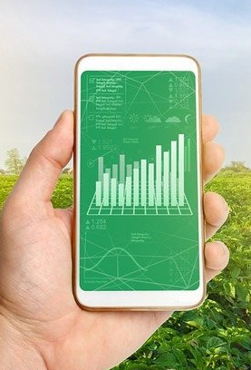
PROBLEM
It is challenging to find out all crops production and statistical information across India at single place where bio-tech industry can find and refer. Below are few of them:
Find out crop which is more suitable to specific season to give more production
Find out Indian cultivation and how its progressing in future.
Find out crop production for different zones (Union Territory, South Zone, NE Zone, East Zone, North Zone, Central Zone and West Zone)
Find out top zone for crop production
Estimating Crop Production based on season

Slide 3
IDEA/SOLUTION
IDEA : Analyzer tool transforms agriculture and biotech industry to decide where & when to plant so that to get best production from crops.
PROPOSED SOLUTION: Exploratory data analysis on Indian Crop dataset available on KAGGLE using programming language Python, VS-Code & DASH-PLOTLY and create Dashboard/Visualization and deploy on HEROKU Hosting platform
Our platform will provide information on seed, appropriate soil, ideal fertilizer and crop base information.
Dataset selection
Data Preparation & Cleaning
Exploratory Data Analysis
Create Dashboard/Visualization
Geospatial Crop Production
State wise Crop Production
Other Statistical Information
Reference :
Programming Language : https://www.python.org/
Dataset : https://www.kaggle.com/datasets/abhinand05/crop-production-in-india
Visualization/Dashboard Packages : https://dash.plotly.com/
Deployment : https://www.heroku.com/
Code Repository : https://github.com/

Slide 4








HOW YOU WOULD APPROACH/BUILD YOUR CONCEPT
High Level Flow
Dataset : KAGGLE
Prog Lang : PYTHON
Development : VSCODE
Package : DASH-PLOTLY
Hosting: HEROKU
Repository: GIT HUB
Visualization
Exploratory Data Analysis

Slide 5
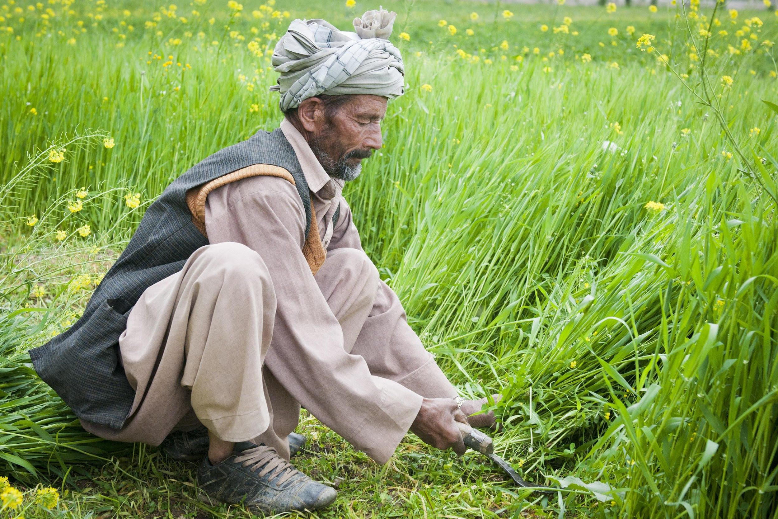

PURPOSE
The purpose to develop this application is to provide information related to agriculture. Every developing economy has agriculture sector as irreplaceable pillar and so does India.
So here’s our small attempt at developing a website which is helpful in giving information regarding our crops.

Slide 6
MAIN AGENDA :
A SMART DATA BASED APPROACH.
TO ILLUSTRATE DIFFERENT STATES AND THEIR OVER ALL CROP PRODUCTION.
ESTIMATION OF SEASON WISE CROPS.
PROJECT OVERVIEW :
To solve problems at the same time by using one application wherein one can get the major details about a crop , mostly its yearly production , seasonality and area based.
Not only to farmers even developers will know about new trending technologies to use and how to implement.

Slide 7
THANK YOU

